Slide 1
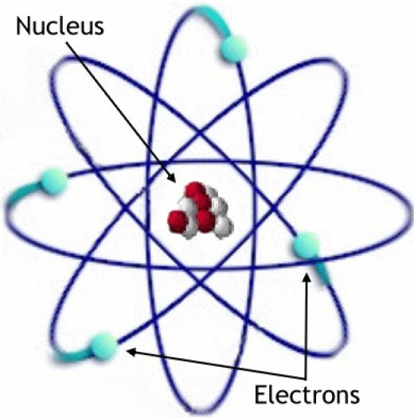
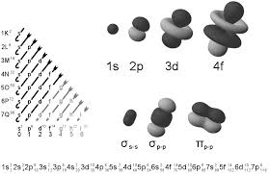
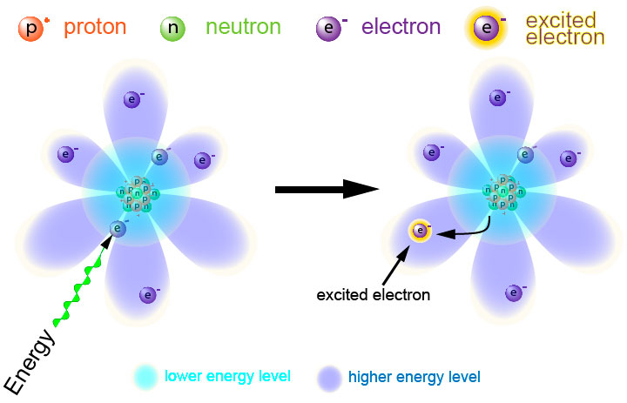
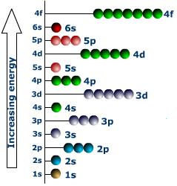
Electrons in Atoms
Chapter 5

Slide 2
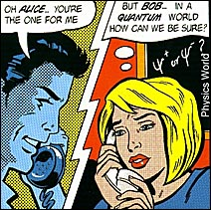
Chapter 5: Electrons in Atoms
5.1 Light and Quantized Energy
Wave nature of light

Slide 3
Wave nature of light- Electromagnetic radiation is a form of energy that exhibits wavelike behavior as it travels through space.
All electromagnetic waves travel at the speed of light (3.00 X 10⁸ m/s in a vacuum).
C = λv

Slide 4
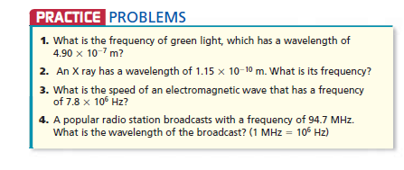
1. 6.12 X 10¹⁴ s⁻¹
2. 2061 X 10¹⁸ s⁻¹
3. 3.0 x 10⁸ m/s
4. 3.17 m

Slide 5
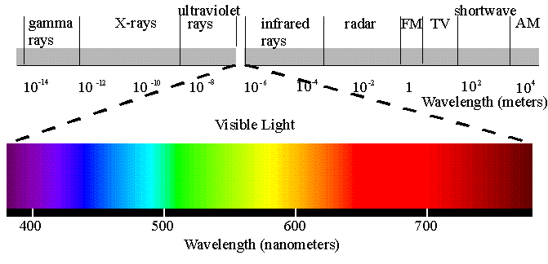
Electromagnetic spectrum

Slide 6
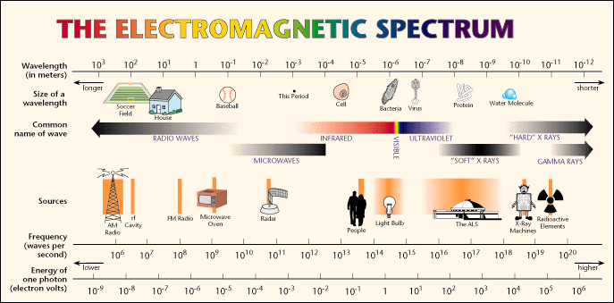

Slide 7
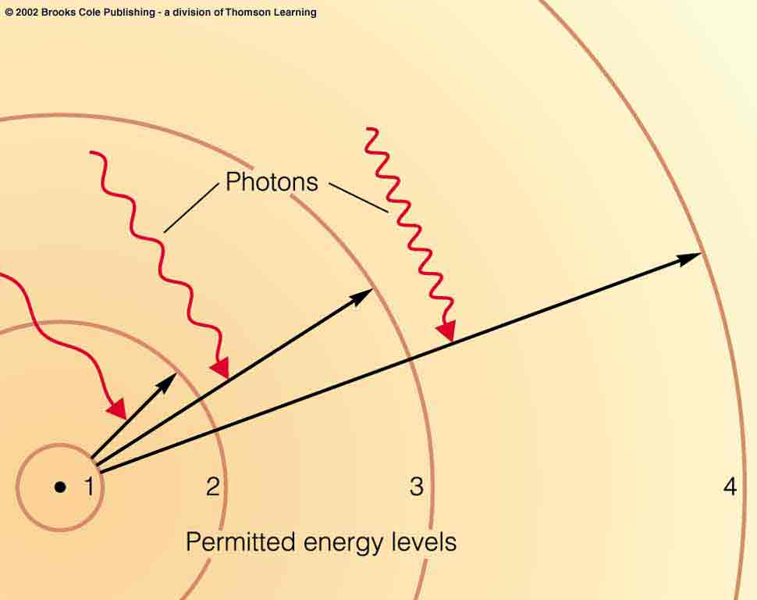
Particle nature of light – photon

Slide 8
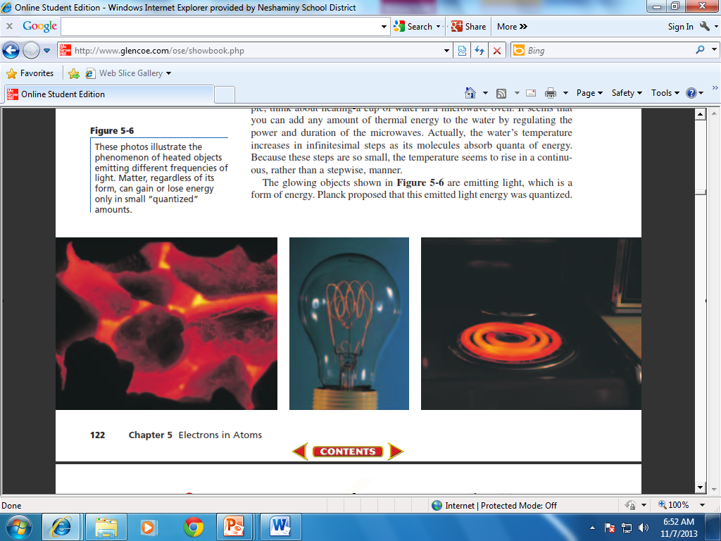
The wave model of light could not explain why heated objects emit only certain frequencies of light at a given temperature.

Slide 9
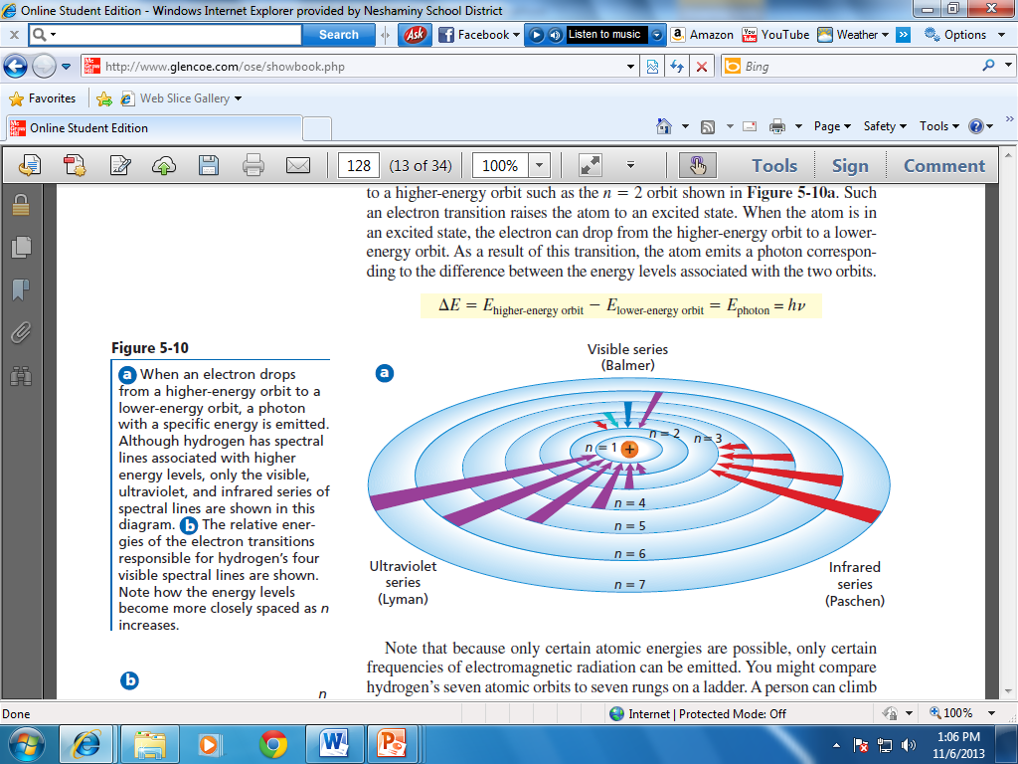
Atomic Emission Spectrum

Slide 10
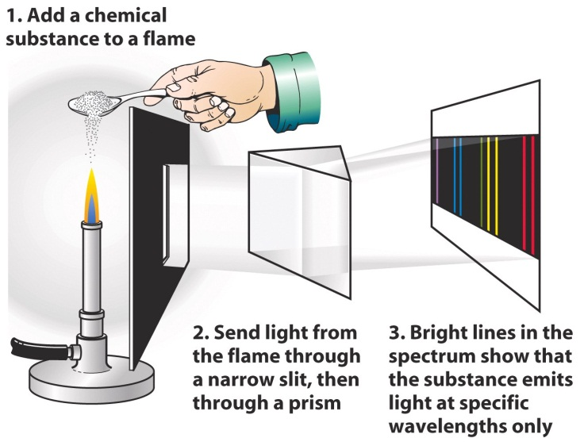

Slide 11
http://www.youtube.com/watch?v=0Mbf1Pfl_2U

Slide 12
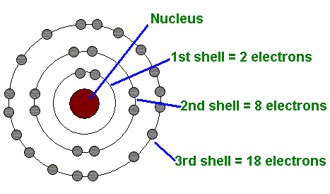
5.2 Quantum Theory of the Atom
Bohr Model of the Atom

Slide 13
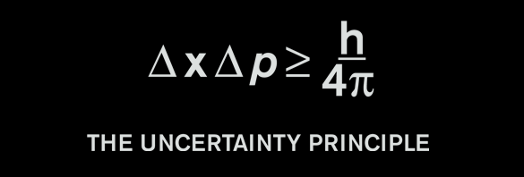
Heisenberg Uncertainty Principle-
Heisenberg Uncertainty Principle- states that it is impossible to know precisely both the velocity and position of a particle at the same time

Slide 14
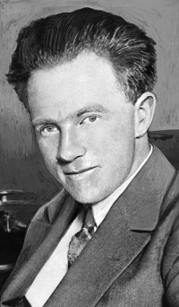
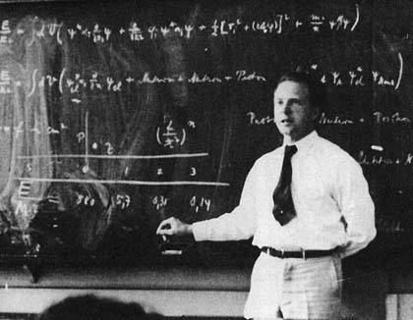
Heisenberg

Slide 15


Slide 16
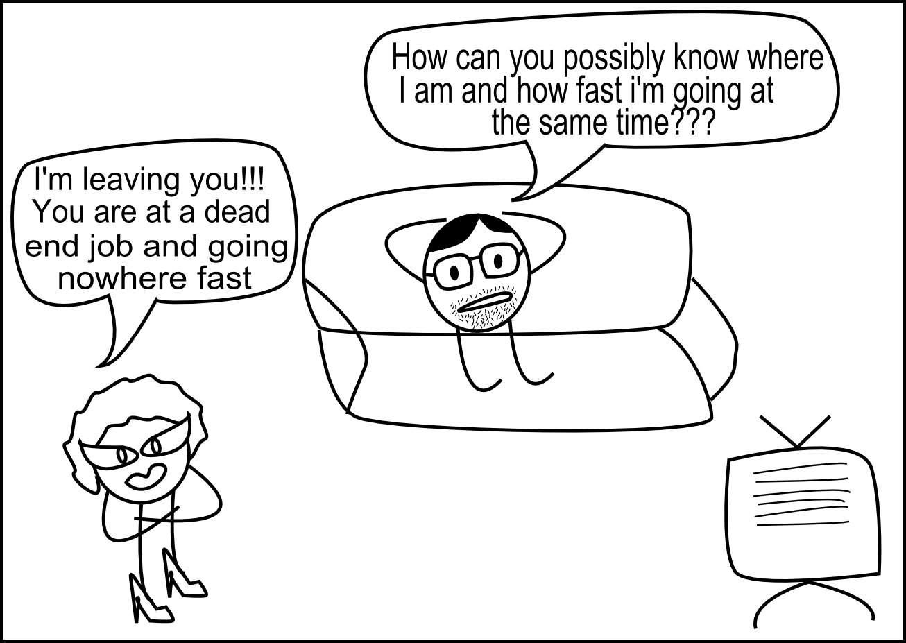

Slide 17
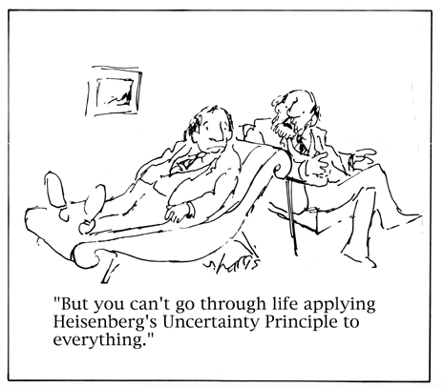

Slide 18
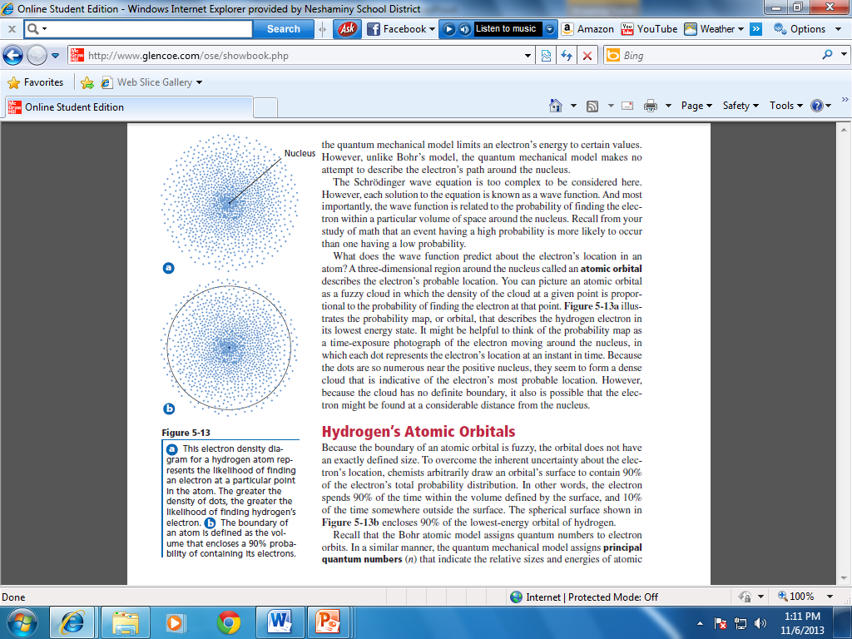

Slide 19
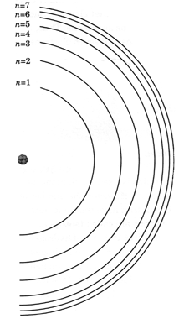
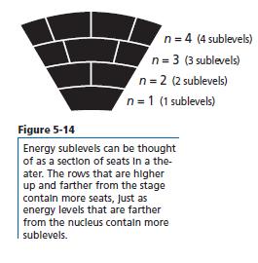
Principle energy levels

Slide 20
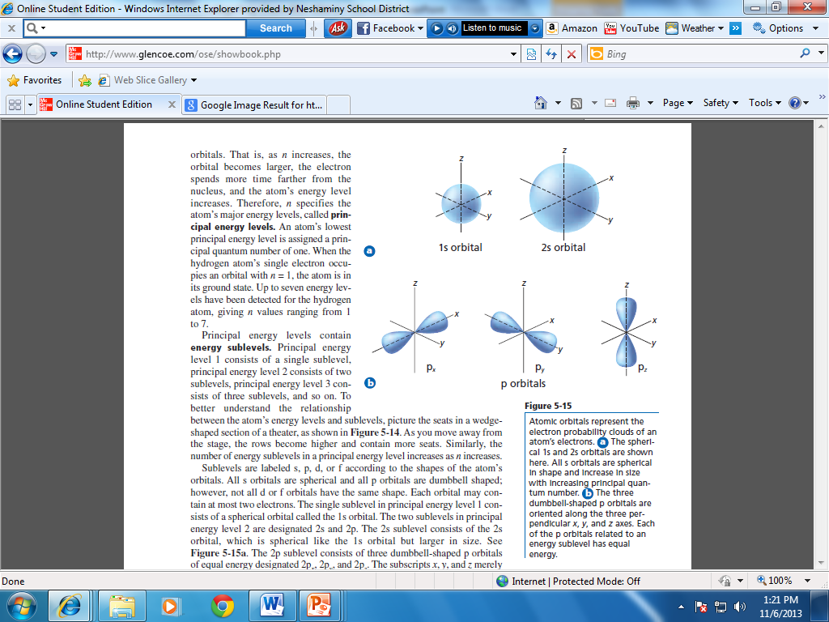
Energy sublevels

Slide 21
Wave Mechanical Model
Quantum Mechanical Model
Mathematical model – based on probability
Predicts energy levels for an atom that can be pictured like Bohr’s orbits
http://www.youtube.com/watch?v=Ic8OnvRonb0&feature=fvst
Only the PROBABILITY of finding an electron in a certain region of the atom is known

Slide 22
Electron Configurations
  The Arrangement of electrons among the various sublevels of an atom.
  Every Atom has A different Electron Configuration

Slide 23
IMPORTANT: Within energy levels there are sublevels, within sublevels there are orbitals
Energy Level
Within energy levels there are sublevels (s,p,d and f)
Within sublevels there are oribitals

Slide 24
Each sublevel fills with electrons before moving to the next sublevel
Each orbital can contain a maximum of 2 electrons

Slide 25
Principal Energy Level | # of Sublevels | Sublevels available
1 | 1 | 1s
2 | 2 | 2s, 2p
3 | 3 | 3s, 3p, 3d
4 | 4 | 4s, 4p, 4d, 4f
5 | 5 | 5s, 5p, 5d, 5f

Slide 26
Sublevel | Max # of electrons | Number of Orbitals
s
p
d
f

Slide 27
Sublevel | Max # of electrons | Number of Orbitals
s | 2 | 1
p | 6 | 3
d | 10 | 5
f | 14 | 7

Slide 28
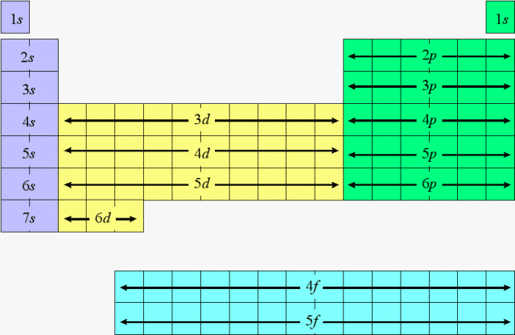

Slide 29
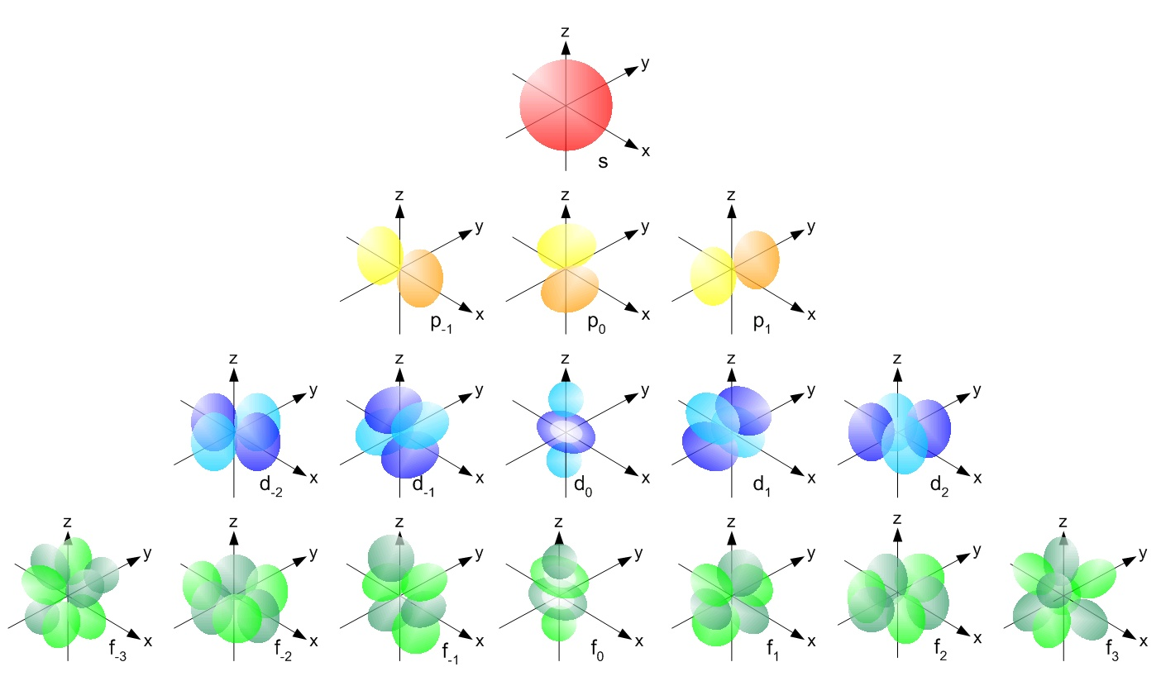
Single Electron Orbital Shapes
sharp, principal, diffuse, and fundamental

Slide 30
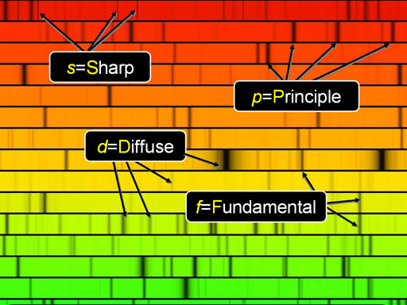

Slide 31
Single Electron Orbital Shapes
sharp, principal, diffuse, and fundamental

Slide 32
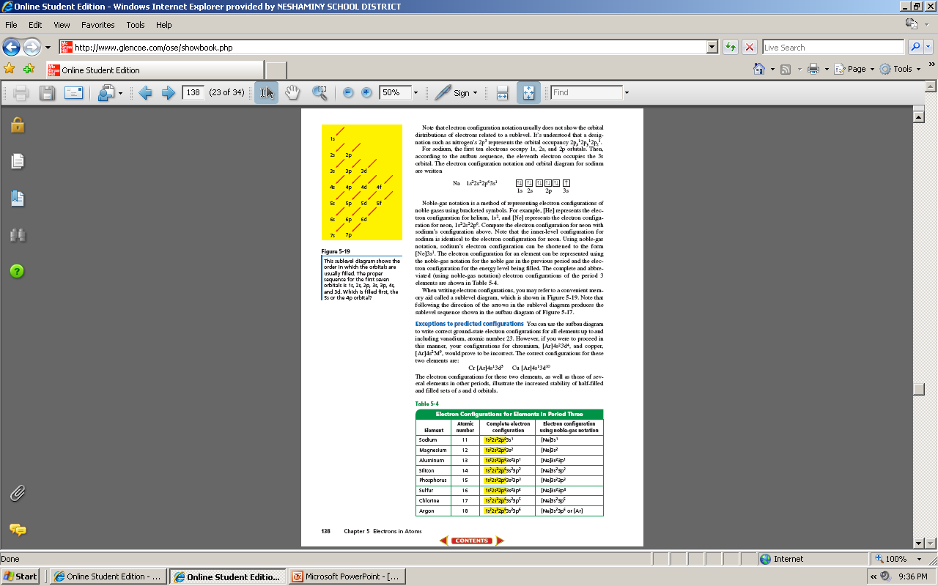

Slide 33

Orbital Notation
Visual representation of how e⁻ are placed in orbitals
In an orbital e⁻ have opposite spins
Electrons are represented by arrows

Slide 34
Notation tells us the PEL, type of sublevel and the # of e⁻ in that sublevel
Ex: 1s²2s²2p⁴

Slide 35
Because low energy systems are more stable than high energy systems, electrons in an
Atom Tend to assume the arrangement that gives the lowest possible energy. This is
Called The Ground State.

Slide 36
Aufbrau Principle- each electron occupies the lowest energy orbital available

Slide 37
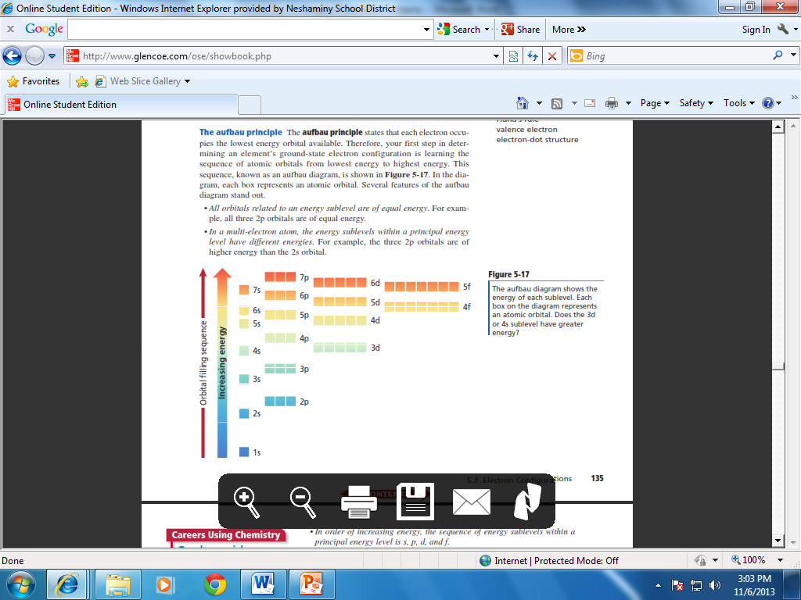

Slide 38
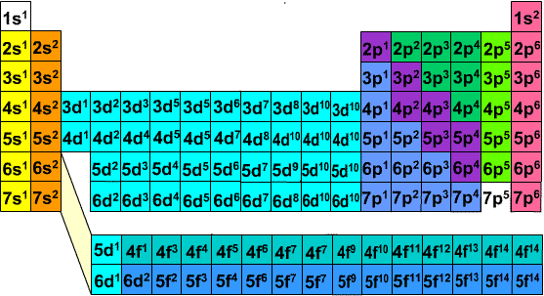

Slide 39
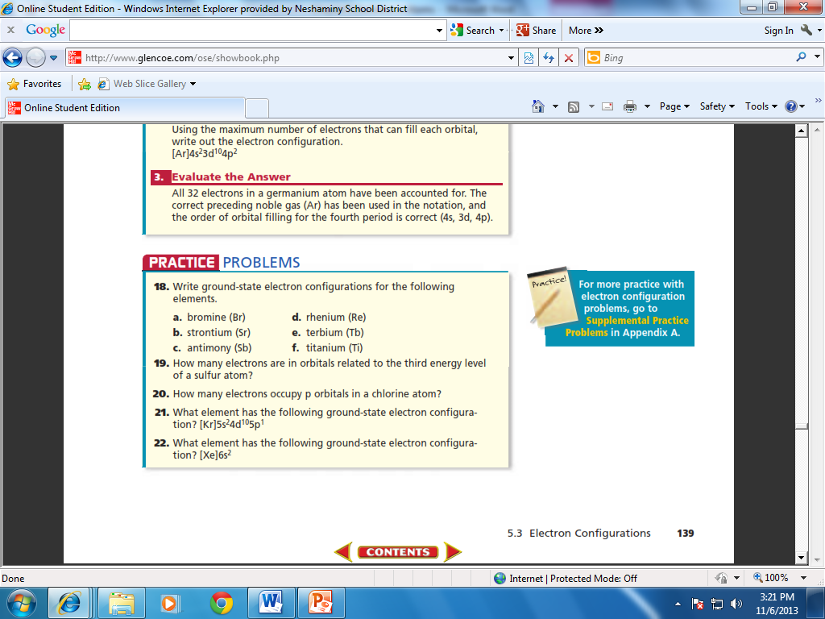

Slide 40
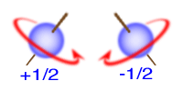
Pauli Exclusion Principle- a maximum of two electrons may occupy a single atomic orbital, but only if the electrons have opposite spins.

Slide 41
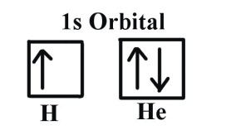
An atomic orbital containing paired electrons with opposite spins is written as

Slide 42
Hund’s Rule When filling sublevels other than s, electrons are placed in individual orbitals before they are paired up.
Electrons fill like people do on a bus. You would never sit right next to someone you did not know if there are free seats available, unless of course all the seats are taken then you must pair up.

Slide 43
Orbital Diagrams/ Notation

Slide 44
Orbital Notation
Visual representation of how e⁻ are placed in orbitals
In an orbital e⁻ have opposite spins
Electrons are represented by arrows

Slide 45
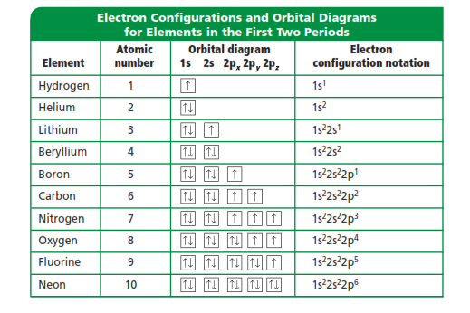

Slide 46
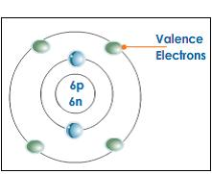
Valence Electrons-
Valence Electrons- are defined as electrons in the atoms outermost orbitals.

Slide 47
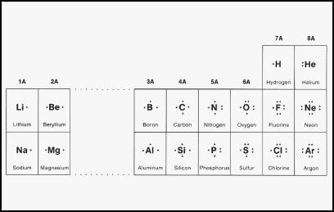
Electron Dot Structure- represent an atoms valence electrons. An atoms electron dot structure consists of the elements symbol, surrounded by dots representing the atoms valence electrons.

Slide 48
